Slide 1
Introduction to Machine Learning

Slide 2
What is Machine Learning?
Definition:
Machine Learning is a subset of artificial intelligence (AI) that focuses on the development of algorithms and statistical models that enable computers to perform specific tasks without explicit instructions.
Instead, these systems learn from data and improve their performance over time.

Slide 3
How ML Works:
ML algorithms analyze and identify patterns in data.
They use these patterns to make predictions or decisions based on new, unseen data.
The learning process can be supervised (using labeled data), unsupervised (finding patterns in unlabeled data), or semi-supervised (a combination of both).

Slide 4
Significance of ML in Data-Driven Decision-Making
Enhanced Decision-Making
Automation of Processes
Personalization
Predictive Analytics
Improved Efficiency
Data-Driven Insights
Scalability

Slide 5
1) Enhanced Decision-Making
ML enables organizations to make informed decisions based on data analysis rather than intuition or guesswork.
By leveraging data-driven insights, businesses can identify trends, forecast outcomes, and optimize strategies.

Slide 6
2) Automation of Processes
Machine Learning can automate repetitive tasks and processes, allowing organizations to focus on more strategic initiatives.
For example, ML algorithms can automate data entry, customer support, and fraud detection.

Slide 7
3) Personalization
ML algorithms can analyze user behavior and preferences to deliver personalized experiences.
For instance, recommendation systems used by e-commerce platforms and streaming services suggest products or content based on individual user data.

Slide 8
4) Predictive Analytics
ML models can predict future trends and behaviors by analyzing historical data.
This capability is valuable in various fields, such as finance (credit scoring), healthcare (disease prediction), and marketing (customer segmentation).

Slide 9
5) Improved Efficiency
By identifying patterns and anomalies in large datasets, ML can help organizations streamline operations, reduce costs, and improve resource allocation.
For example, predictive maintenance in manufacturing can minimize downtime by anticipating equipment failures.

Slide 10
6) Data-Driven Insights
ML provides organizations with actionable insights derived from data analysis.
These insights can inform strategic planning, product development, and market positioning.

Slide 11
7) Scalability
Machine Learning models can handle vast amounts of data and adapt to new information, making them scalable solutions for growing businesses.
As more data becomes available, ML systems can continuously learn and improve.

Slide 12
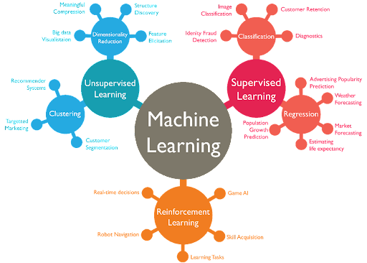
Types of Machine Learning

Slide 13
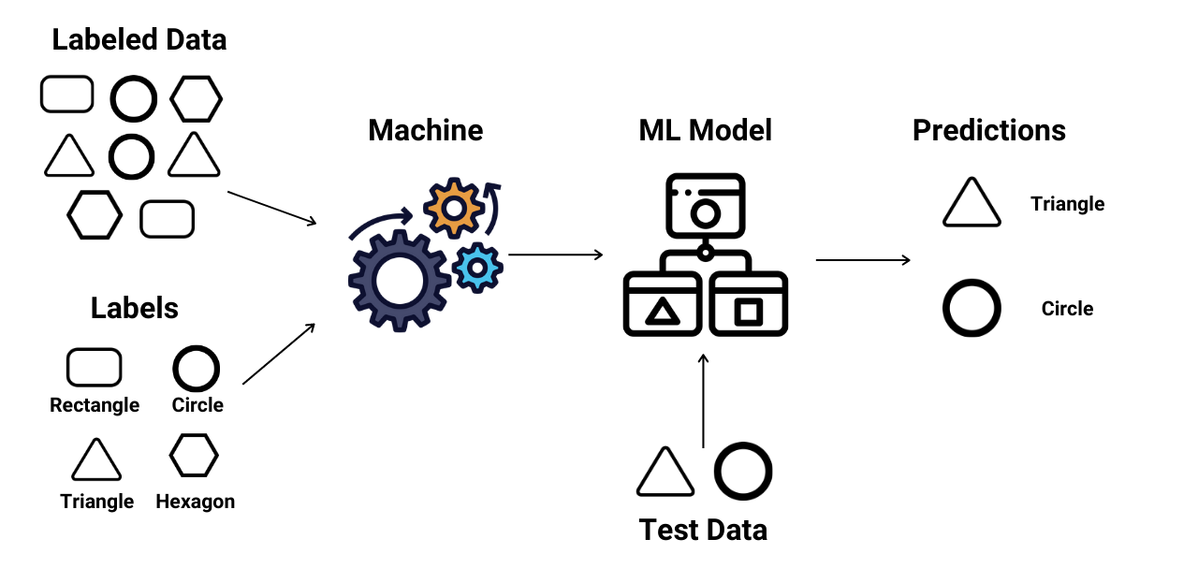
Supervised Learning
Involves training a model on a labeled dataset, where the desired output is known.
The model learns to map inputs to outputs and can make predictions on new data.

Slide 14
Supervised Learning : Applications
Classification: Identifying categories (e.g., email spam detection, sentiment analysis).
Regression: Predicting continuous values (e.g., house price prediction, stock price forecasting).
Medical Diagnosis: Classifying diseases based on patient data and symptoms

Slide 15
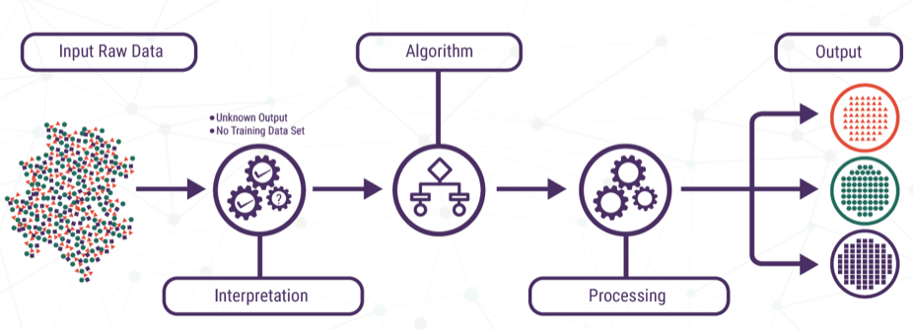
Unsupervised Learning
Involves training a model on an unlabeled dataset, where the model tries to find hidden patterns or intrinsic structures in the input data.

Slide 16
Unsupervised Learning : Applications
Clustering: Grouping similar items (e.g., customer segmentation, market basket analysis).
Anomaly Detection: Identifying unusual data points (e.g., fraud detection in financial transactions).
Dimensionality Reduction: Reducing the number of features while preserving important information (e.g., Principal Component Analysis for data visualization).

Slide 17
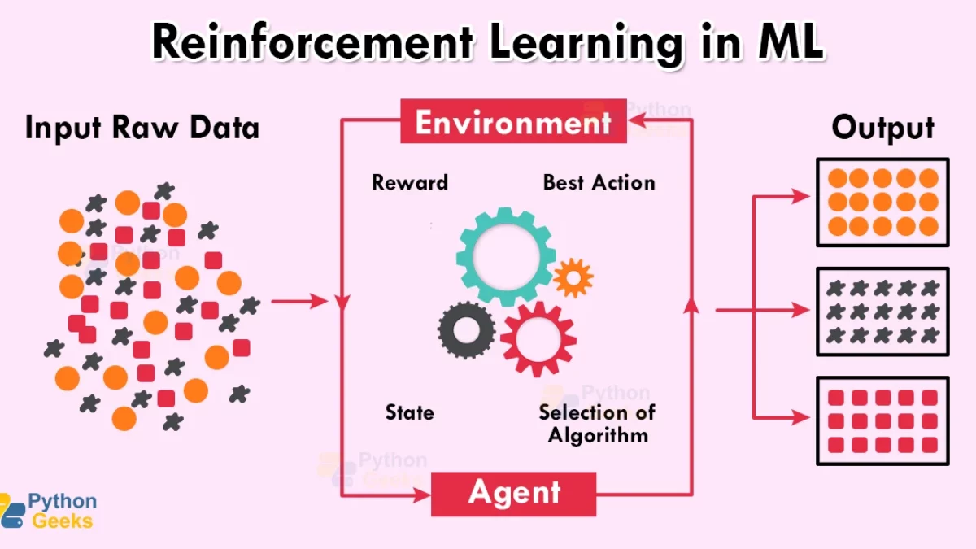
Reinforcement Learning
Involves training an agent to make decisions by taking actions in an environment to maximize cumulative reward.
The agent learns from the consequences of its actions.

Slide 18
Reinforcement Learning : Applications
Game Playing: Training AI to play games (e.g., AlphaGo, chess).
Robotics: Teaching robots to perform tasks (e.g., navigation, manipulation).
Autonomous Vehicles: Enabling self-driving cars to make real-time driving decisions based on their environment.

Slide 19
ML Workflow Overview
Problem Definition
Data Collection
Data Pre-processing
Exploratory Data Analysis (EDA)
Model Selection
Model Training
Model Evaluation
Hyperparameter Tuning
Model Deployment
Monitoring and Maintenance

Slide 20
1) Problem Definition
Objective: Clearly define the problem you want to solve with machine learning.
Outcome: Establish the goals and success criteria for the ML project.

Slide 21
2) Data Collection
Objective: Gather relevant data from various sources.
Outcome: Create a dataset that will be used for training and testing the model.
Sources: Databases, APIs, web scraping, surveys, etc.

Slide 22
3) Data Pre-processing
Objective: Clean and prepare the data for analysis.
Tasks:
Handling Missing Values: Fill in or remove missing data points.
Data Transformation: Normalize or standardize data, encode categorical variables.
Feature Engineering: Create new features that may improve model performance.
Outcome: A clean and structured dataset ready for modeling.

Slide 23
4) Exploratory Data Analysis (EDA)
Objective: Analyze the dataset to understand its characteristics and relationships.
Tasks:
Visualize data distributions and relationships using plots.
Identify patterns, trends, and anomalies.
Outcome: Insights that inform feature selection and model choice.

Slide 24
5) Model Selection
Objective: Choose the appropriate machine learning algorithm(s) based on the problem type (classification, regression, etc.).
Outcome: A selected model or set of models to train on the dataset.

Slide 25
6) Model Training
Objective: Train the selected model(s) using the training dataset.
Tasks:
Split the dataset into training and validation sets.
Fit the model to the training data.
Outcome: A trained model that can make predictions.

Slide 26
7) Model Evaluation
Objective: Assess the model's performance using evaluation metrics.
Tasks:
Use the validation dataset to evaluate the model.
Calculate metrics such as accuracy, precision, recall, F1 score, or mean squared error, depending on the problem type.
Outcome: An understanding of how well the model performs and whether it meets the success criteria.

Slide 27
8) Hyperparameter Tuning
Objective: Optimize the model's performance by adjusting hyperparameters.
Tasks:
Use techniques like grid search or random search to find the best hyperparameter values.
Outcome: An improved model with better performance metrics.

Slide 28
9) Model Deployment
Objective: Deploy the trained model to a production environment where it can make predictions on new data.
Tasks:
Integrate the model into applications or services.
Monitor the model's performance in real-time.
Outcome: A functioning ML model that provides value to users.

Slide 29
10) Monitoring and Maintenance
Objective: Continuously monitor the model's performance and update it as needed.
Tasks:
Track model accuracy and performance over time.
Retrain the model with new data if performance degrades.
Outcome: A robust and reliable ML system that adapts to changing data and requirements.

Slide 30
Evaluation Techniques
Evaluation techniques in machine learning refer to the methods and metrics used to assess the performance of a machine learning model.
These techniques help determine how well a model is performing on a given task, whether it is making accurate predictions, and how it generalizes to unseen data.
Evaluation is a critical step in the machine learning workflow, as it informs decisions about model selection, tuning, and deployment.

Slide 31
Importance of Evaluation
Performance Assessment
Model Comparison
Understanding Model Behavior
Identifying Issues
Guiding Model Improvement
Ensuring Reliability
Facilitating Communication
Supporting Decision-Making

Slide 32
1) Performance Assessment
Evaluation techniques allow us to measure how well a machine learning model performs on a given task. By assessing performance, we can determine if the model meets the desired accuracy and effectiveness for its intended application.

Slide 33
2) Model Comparison
Evaluation metrics enable the comparison of different models or algorithms.
By using standardized metrics, we can identify which model performs best for a specific problem, helping in the selection of the most suitable approach.

Slide 34
3) Understanding Model Behavior
Evaluation provides insights into how a model makes predictions.
By analyzing metrics, we can understand the strengths and weaknesses of the model, such as its ability to generalize to unseen data or its tendency to overfit.

Slide 35
4) Identifying Issues
Evaluation techniques help identify potential issues in the model, such as bias, variance, or data leakage.
Understanding these issues is crucial for improving model performance and ensuring fairness in predictions.

Slide 36
5) Guiding Model Improvement
The evaluation process highlights areas where the model can be improved.
By analyzing performance metrics, data scientists can make informed decisions about feature engineering, hyperparameter tuning, or selecting different algorithms.

Slide 37
6) Ensuring Reliability
Regular evaluation of models ensures that they remain reliable over time.
As new data becomes available or as the underlying data distribution changes, continuous evaluation helps maintain model performance and relevance.

Slide 38
7) Facilitating Communication
Evaluation metrics provide a common language for discussing model performance among stakeholders, including data scientists, engineers, and business leaders. Clear metrics help convey the effectiveness of the model and its impact on business objectives.

Slide 39
8) Supporting Decision-Making
In data-driven environments, evaluation techniques support decision-making processes.
By providing quantitative assessments of model performance, organizations can make informed choices about deploying models, allocating resources, and prioritizing projects.

Slide 40
Common Evaluation Techniques
Classification Metrics
Regression Metrics
Cross-Validation
Confusion Matrix
ROC Curve and AUC

Slide 41
1) Classification Metrics
Accuracy: The proportion of correct predictions out of total predictions.
Precision: The ratio of true positive predictions to the total predicted positives.
Recall (Sensitivity): The ratio of true positive predictions to the actual positives.
F1 Score: The harmonic mean of precision and recall, providing a balance between the two.

Slide 42
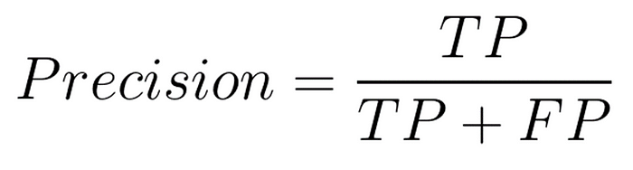
Classification Metrics : Precision
Definition: Precision is the proportion of true positive predictions (correct positive predictions) out of all the positive predictions made by the model.
Interpretation: It tells us how many of the predicted positive instances are actually positive. A high precision means that when the model predicts a positive class, it is mostly correct.
Use Case: Precision is crucial when the cost of false positives is high.
For example, in email spam detection, if the model incorrectly classifies an important email as spam, that could be problematic.

Slide 43
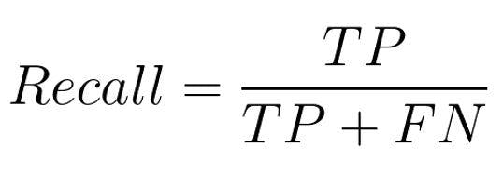
Classification Metrics : Recall
Definition: Recall is the proportion of true positive predictions out of all the actual positive instances in the dataset (i.e., how many of the actual positives were captured by the model).
Interpretation: It tells us how many of the actual positive instances were successfully predicted by the model. A high recall means that the model is good at identifying positive instances, even if it sometimes makes mistakes (false positives).
Use Case : Recall is important when the cost of false negatives is high.
For example, in medical diagnosis (like cancer detection), we want to catch as many positive cases as possible, even if that means incorrectly labeling some healthy patients as sick.

Slide 44
Classification Metrics : Precision & Recall
Summary of the Difference:
Precision focuses on the accuracy of the positive predictions made by the model.
Recall focuses on how well the model can capture all the positive cases in the data.
Trade-off:
There is often a trade-off between precision and recall: optimizing one may decrease the other.
F1-Score is a commonly used metric that combines both precision and recall into a single value to balance the two.

Slide 45
2) Regression Metrics
Mean Absolute Error (MAE): The average of absolute differences between predicted and actual values.
Mean Squared Error (MSE): The average of squared differences between predicted and actual values.
R-squared: A statistical measure that represents the proportion of variance for a dependent variable that's explained by an independent variable or variables.

Slide 46
3) Cross-Validation
A technique used to assess how the results of a statistical analysis will generalize to an independent dataset.
It involves partitioning the data into subsets, training the model on some subsets, and validating it on others.

Slide 47
4) Confusion Matrix
A table used to describe the performance of a classification model by comparing predicted and actual classifications.
It provides insights into true positives, false positives, true negatives, and false negatives.

Slide 48
5) ROC Curve and AUC
The Receiver Operating Characteristic (ROC) curve is a graphical representation of a classifier's performance across different thresholds.
The Area Under the Curve (AUC) quantifies the overall ability of the model to discriminate between classes.

Slide 49
Library
pip install scikit-learn

Slide 50
Regression Evaluation Metrics
Mean Absolute Error (MAE)
Mean Squared Error (MSE)
Root Mean Squared Error (RMSE)
R-squared (R²) or Coefficient of Determination
Adjusted R-squared
Mean Absolute Percentage Error (MAPE)

Slide 51
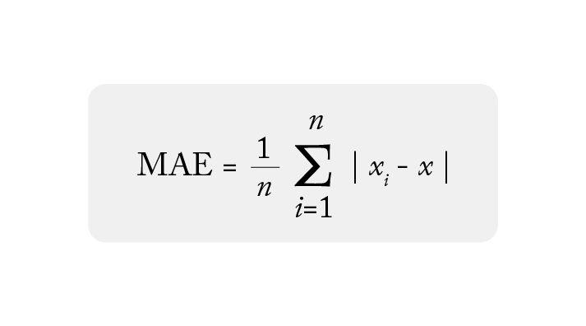
Regression Evaluation Metrics : Mean Absolute Error (MAE)
Description: It measures the average of the absolute differences between the actual and predicted values. MAE gives a sense of how far off the predictions are in general.

Slide 52
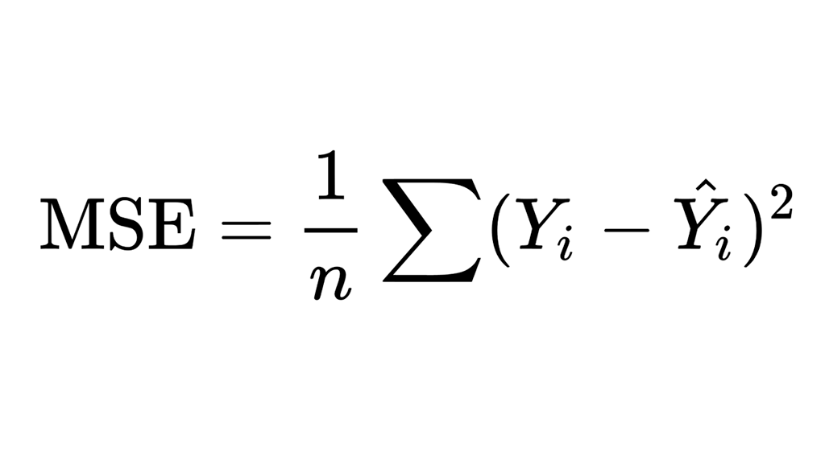
Regression Evaluation Metrics : Mean Squared Error (MSE)
Description: It measures the average of the squared differences between the actual and predicted values. MSE penalizes larger errors more than smaller ones, making it sensitive to outliers.

Slide 53
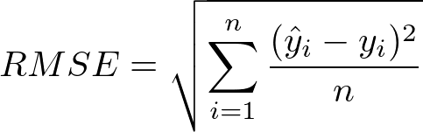
Regression Evaluation Metrics : Root Mean Squared Error (RMSE)
Description: It provides the square root of the MSE. RMSE has the same units as the original data, making it easier to interpret.

Slide 54
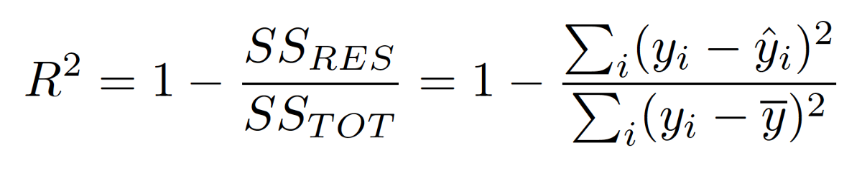
Regression Evaluation Metrics : R-squared (R²) or Coefficient of Determination
Description: R² tells you how well the regression model explains the variance in the data. A value of 1 indicates perfect prediction, while a value of 0 means the model is no better than predicting the mean of the target variable.

Slide 55
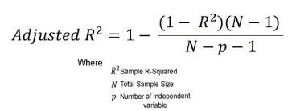
Regression Evaluation Metrics :Adjusted R-squared
Description: Adjusted R² is a modified version of R² that accounts for the number of predictors in the model.
It is useful when comparing models with different numbers of predictors.

Slide 56
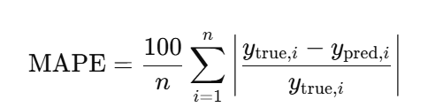
Regression Evaluation Metrics :Mean Absolute Percentage Error (MAPE)
Description: It measures the percentage difference between the actual and predicted values. It's often used for forecasting.

